Slide 1
Big Mountain ticket price modeling & prediction
Jinhui Shen

Slide 2
Problem Statement Worksheet (Hypothesis Formation)
What can Big Mountain Resort do to buffer an additional $1,540,000 chair lift operating costs and gain at least 10% business revenue increase by the end of this ski season?
H
1
Context
4
Constraints within solution space
Big Mountain Resort, a Montana ski resort offers spectacular views of Glacier National Park and Flathead National Forest, with access to 105 trails, 11 lifts, 2 T-bars, and 1 magic carpet accommodating about 350,000 skiers and riders of all levels every year. The resort installed an additional chair lift recently to help increase the distribution of visitors across the mountain, which increases operating costs by $1,540,000 this season. Management is seeking guidance on a better ticket pricing strategy for the value of the facilities than basing on the market average, and changes that will either cut costs without undermining the ticket price or will support a higher ticket price.
Same market share resorts data in the US is limited to 330 resorts.
There might be missing data in the source data.
Resistance from current pricing strategy team used to charge a premium above the average price of resorts.
5
Stakeholders to provide key insight
Jimmy Blackburn - Director of Operations
Alesha Eisen - Database Manager
2
Criteria for success
New ticket prices based on resort facilities value will not only buffer the additional $1,540,000 chair lift operating costs, but also gain at least 10% business revenue increase by the end of this season.
6
Key data sources
3
Scope of solution space
CSV file - contains resorts location, elevation change, facilities, average annual snowfall inches, opening days, adult ticket price.
Wikipedia data - contains state population and area of the US.
Analyze facilities and prices data of 330 resorts in the US considered part of the same market share including current data of Big Mountain Resort.
H
D
E
I
P

Slide 3
Recommendation and key findings
The predicted 'AdultWeekday' price for Big Mountain is $92.41, vs. current price $81, with an expected mean absolute error $10.41, modeled price is in the range [$82 - $102.82].
Price increase of $0.88 would cover the additional $1,540,000 cost for the new chair lift, if the expected number of visitors over the season is 350,000 and each will buy 5-day tickets on average.
The predicted increase space is much more than $0.88, at least 10% revenue increase is quite possible by the end of this season. Business costs and visitor data would help for a better prediction.
Big Mountain has above average or high rankings in ['vertical_drop', 'fastQuads', 'total_chairs', 'Runs', 'SkiableTerrain_ac', 'Snow Making_ac’, 'LongestRun_mi’] among market share. These are key marketing points and prioritized factors when considering future improvements.
Increasing the vertical drop by adding a run to a point 150 feet lower down without additional snow making coverage could increase ticket price by $0.40.
Adding 2 acres of snow making to the added run and vertical drop won't support price increase.
Increasing the longest run by 0.2 miles and guaranteeing its snow coverage by adding 4 acres of snow making capability doesn't help with price increase.
Closing down 1 to 5 of the least used runs would support price decrease of $0.15 to $0.61, but probably no more than 5 runs.

Slide 4
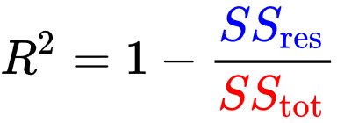
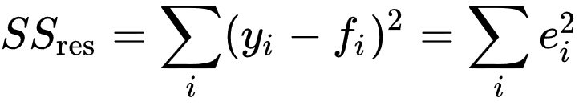
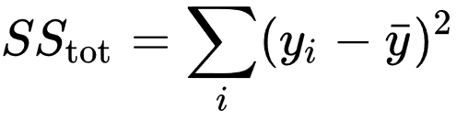
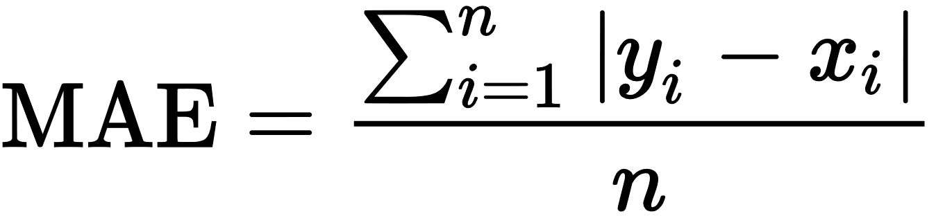
Modeling results and analysis
Prediction performance metrics
Different methods performance
The closer R² to 1, the better performance
The smaller MAE, the better performance
Prediction performance metrics | R² | STD of R² | MAE
Previous Mean predictor strategy | -0.0015 |  | $18.67
Linear Regression Modeling (k=15) | 0.625 | 0.084 | $10.31
Random Forest Regression Modeling (with best params) | 0.691 | 0.074 | $9.71
Result | Predicted Price | MAE
Big Mountain | $92.41 | $10.41
Refit
*
Selected model

Slide 5
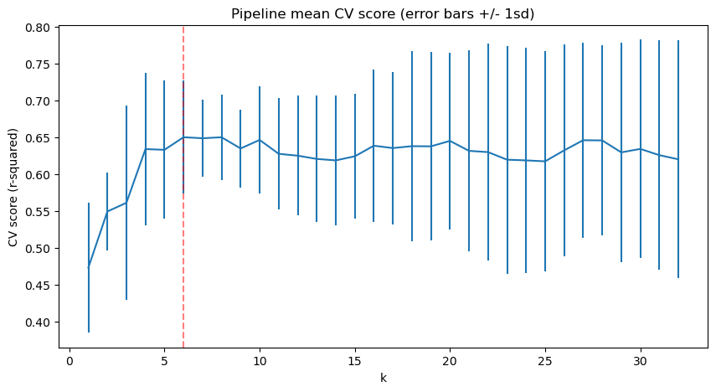
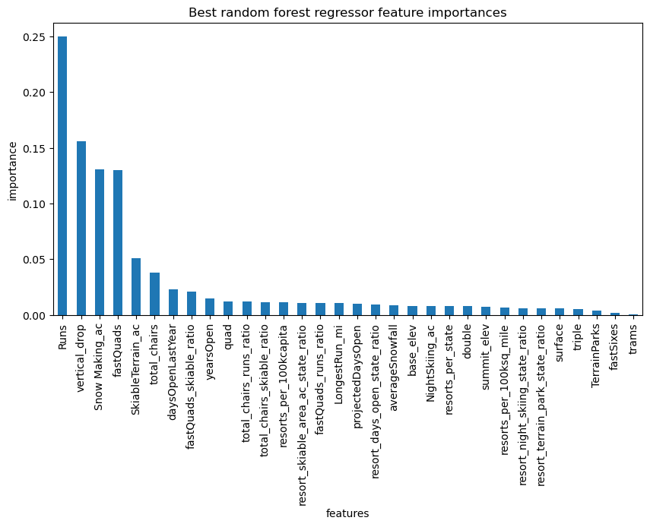
Modeling results and analysis (cont.)
Six most important features contributing to price identified

Slide 6
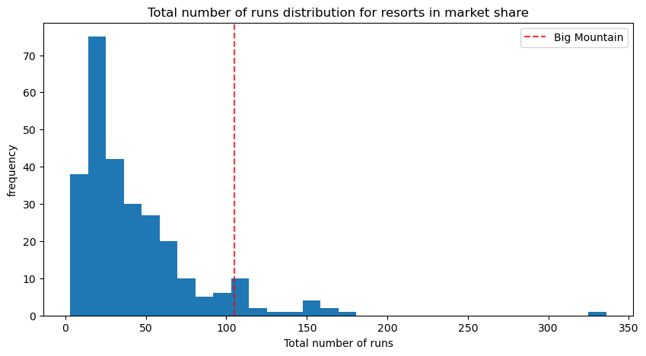
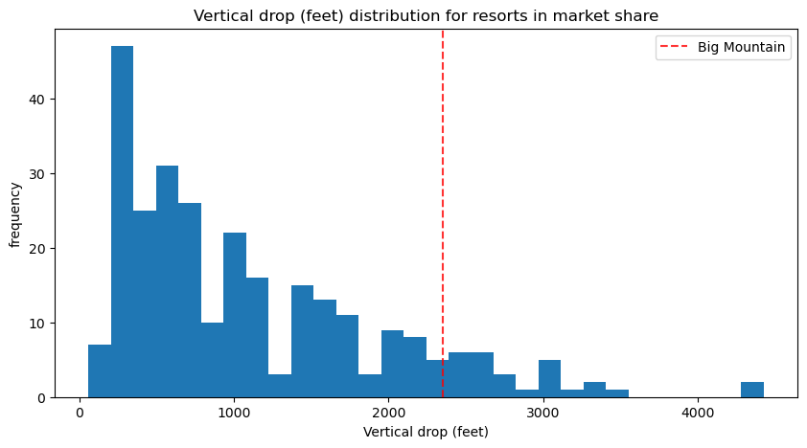
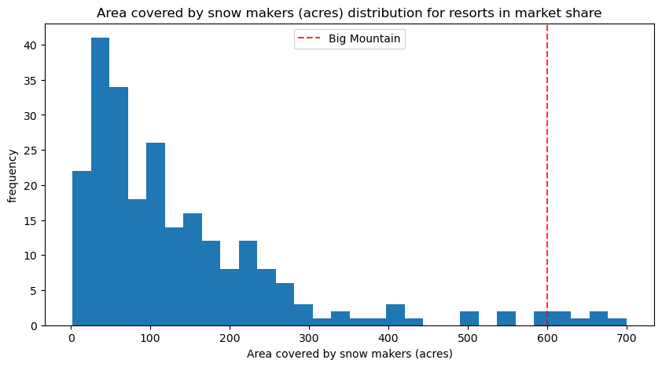
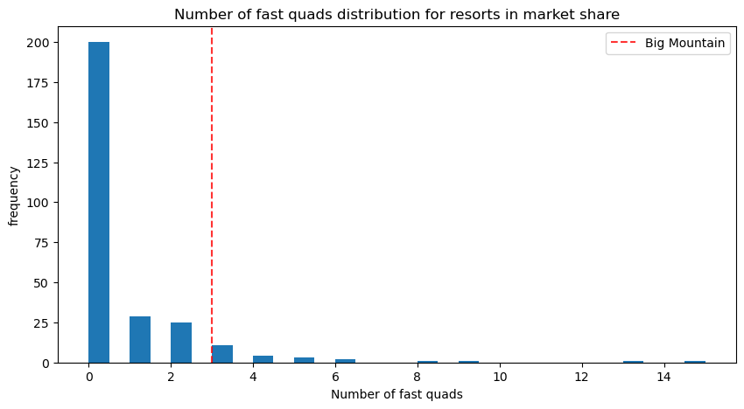
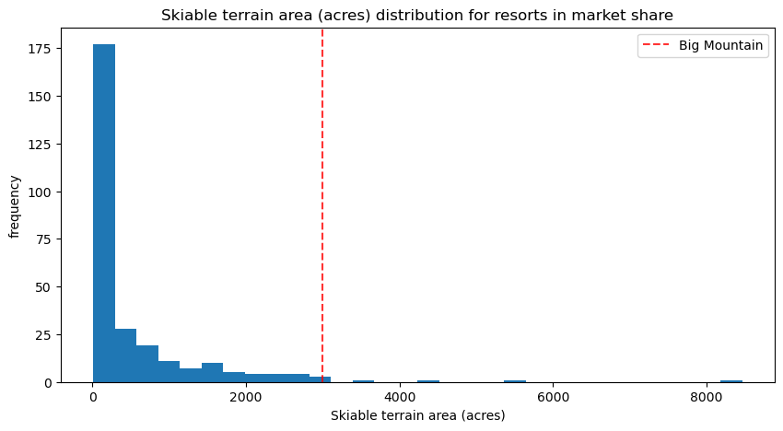
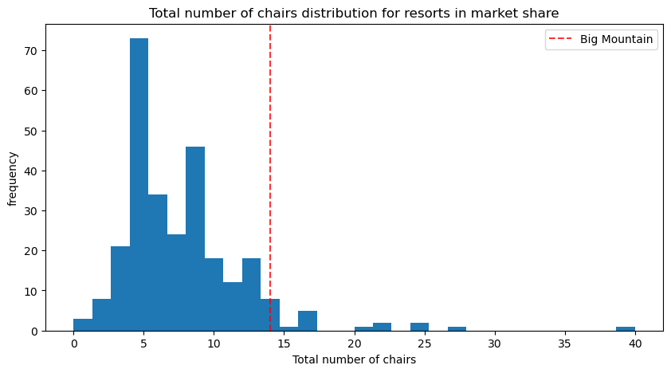
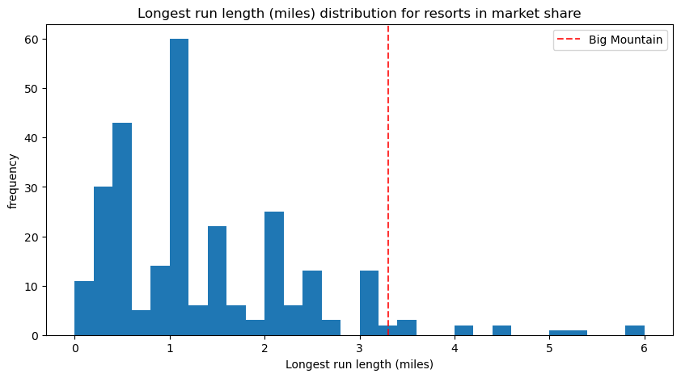
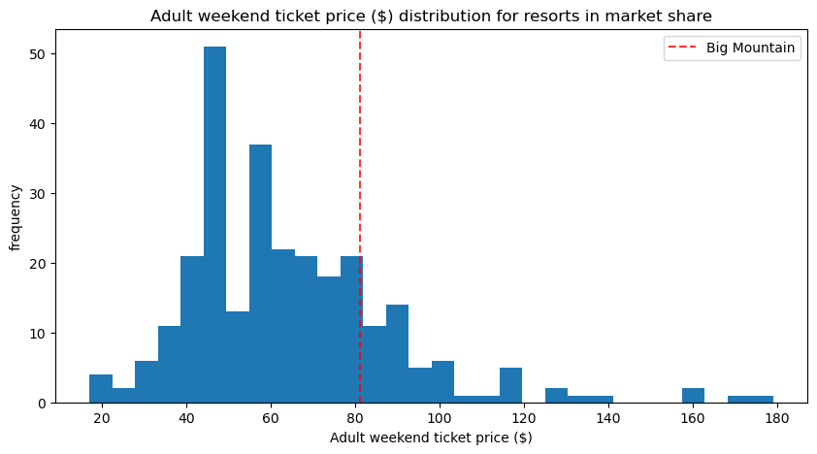
Modeling results and analysis (cont.)
Ranking of Big Mountain on key features and current price supports a price increase

Slide 7
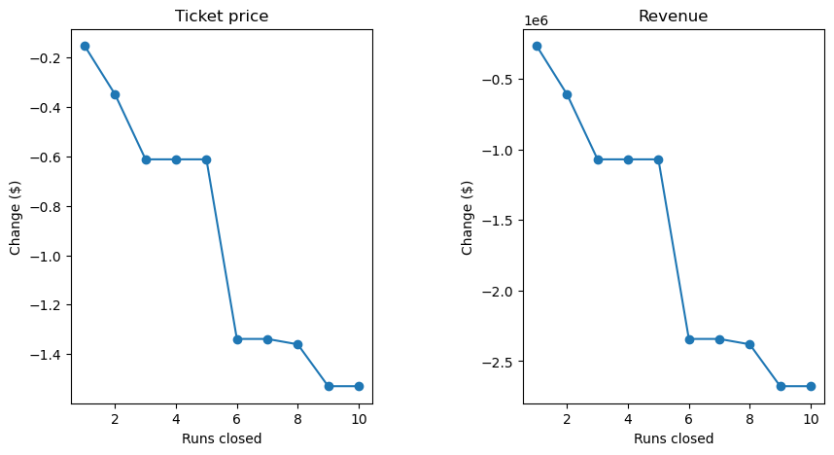
Modeling results and analysis (cont.)
Scenarios modeling of increasing the vertical drop by adding a run to a point 150 feet lower down could increase ticket price by $0.40.
Closing down the least used runs, but no more than 5 runs.
The other two scenarios won’t support price increase.

Slide 8
Summary and conclusion
Based on the current data and random forest regression modeling, Big Mountain has fairly high ranking on some league charts of facilities to offer, and seems to be undercharging.
There is plenty room for price increase based on modeling, to cover the additional lift cost, and to increase at least 10% revenue increase by the end of this season.
More data can be obtained for better prediction and estimation of revenue increase, such as visitor number and average staying days data, weather temperature, geographic latitude, transportation convenience, accommodations like hotels and restaurants numbers on site, and business costs, etc.
Small tests can be done to test modeled improvement scenarios, with comparison and visitor feedbacks to see primary results and then further prediction and recommendations.

Slide 9
Thank you!

